Slide 1
Managing the Boards
A Reference Guide For Product Management & Engineering Teams

Slide 2
WELCOME
This document is a guide to help with the cross-functional collaboration between all the people involved in the software development lifecycle.
The primary aim of this document is to help you understand and manage the development boards based on our own methods used at Applaud.
It is not a document designed with partners or customers in mind, but rather as a reference and for educational purposes.
Each organization has elements of the software development process that are unique to them and Applaud are no different – it is up to you to find an approach that suits for your organization!
Good luck and we hope you enjoy reading about us……….

Slide 3
QUICK POINT ON TERMINOLOGY 1
Depending on where you have worked previously, how you have learned agile or how you’ve been taught at college, you may or may not use different terminology for certain aspects of the development process.
Sprints vs Milestones We tend to use these terms interchangeably at the moment - both refer to a defined period of time in which we aim to complete a pre-agreed body of work, broken down into stories. In product development we use a milestone but refer to the period as sprints - confusing at first for new joiners, so apologies for that!
ZenHub gave us a scare recently when they announced that they were supporting milestones (which we use for our calendar month product level planning), in favour of sprints - which would be a maximum of two week periods.
Thanks to calls we’ve had with ZenHub, they have decided to push back this change - but it will come along at some point in 2022, and at that point we will need to make changes to move from using milestones to sprints.

Slide 4
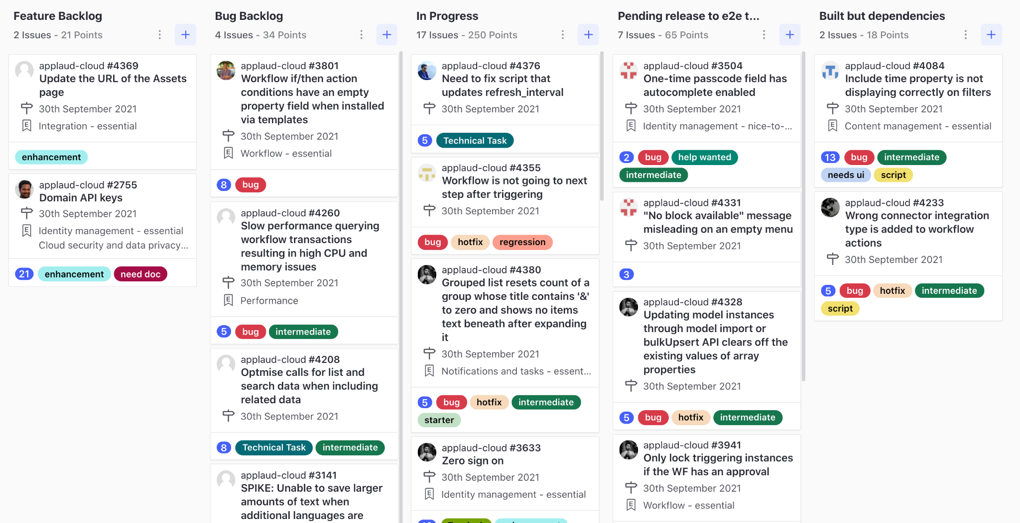
QUICK POINT ON TERMINOLOGY - 2
Another place where the terminology gets a bit mixed up is pipelines and swimlanes - again, this is not really anything to worry about when you first join.
Pipeline or swimlane?
Within Applaud, we use a GitHub extension called ZenHub — this gives us a Kanban board which is divided up into pipelines. Depending on how you have learned agile, you may have used the term ‘swimlane’ — it’s the same principal, just different wording.
+

Slide 5
GETTING STARTED

Slide 6
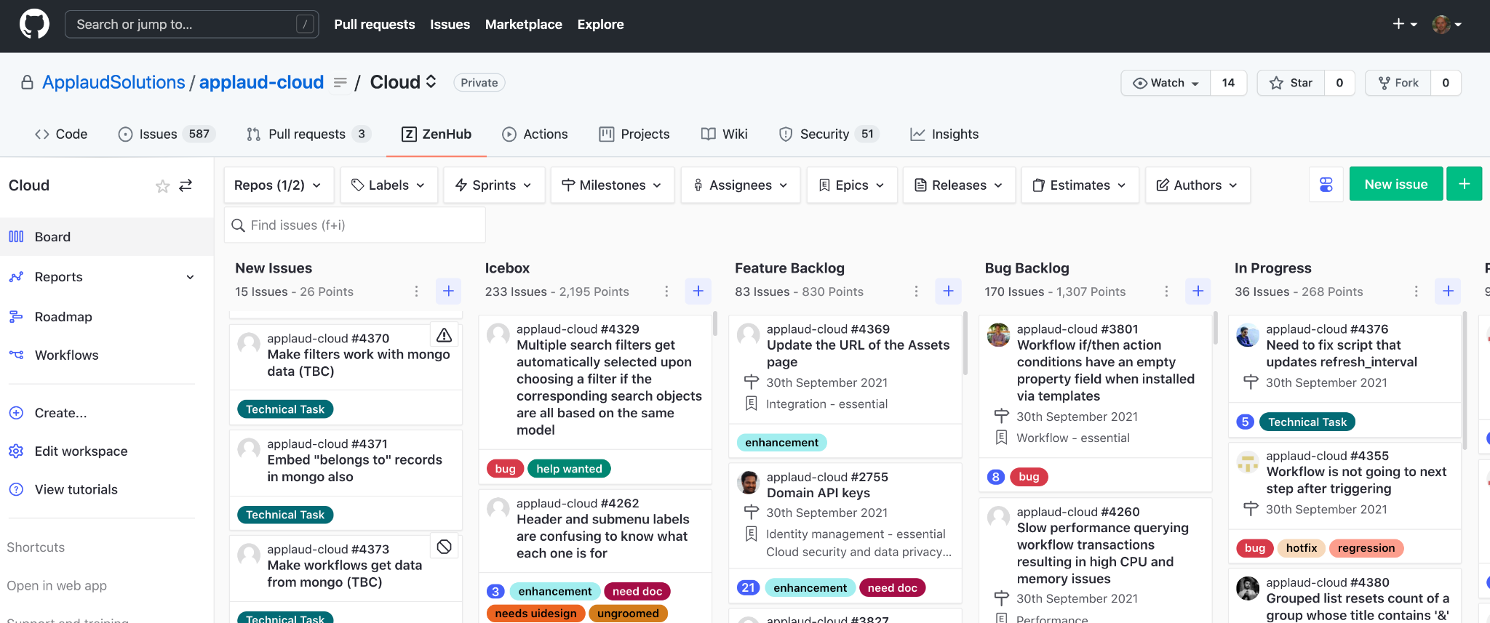
GETTING STARTED - ZenHub
Our development boards are powered by ZenHub.
ZenHub is the only purpose-built agile project management solution built directly into GitHub for GitHub users. Its simple browser extension or web app allows teams to add powerful tracking, planning and reporting features to their GitHub instance, so they can make their agile development processes even more agile and maximize team efficiency.
Set up ZenHub
a) install the ZenHub Chrome Browser Extension
b) request a license from your manager (Applaud employees only)
c) once setup and logged in, when you visit the GitHub URL of your project, you should see a new tab on the project navigation menu labelled “ZenHub”. This Kanban board will become a big part of your life :-)
+

Slide 7
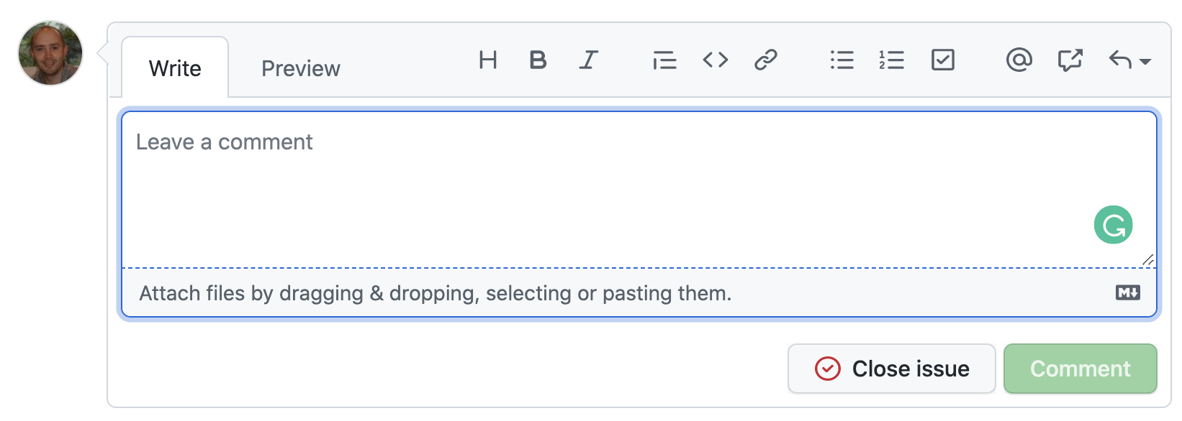
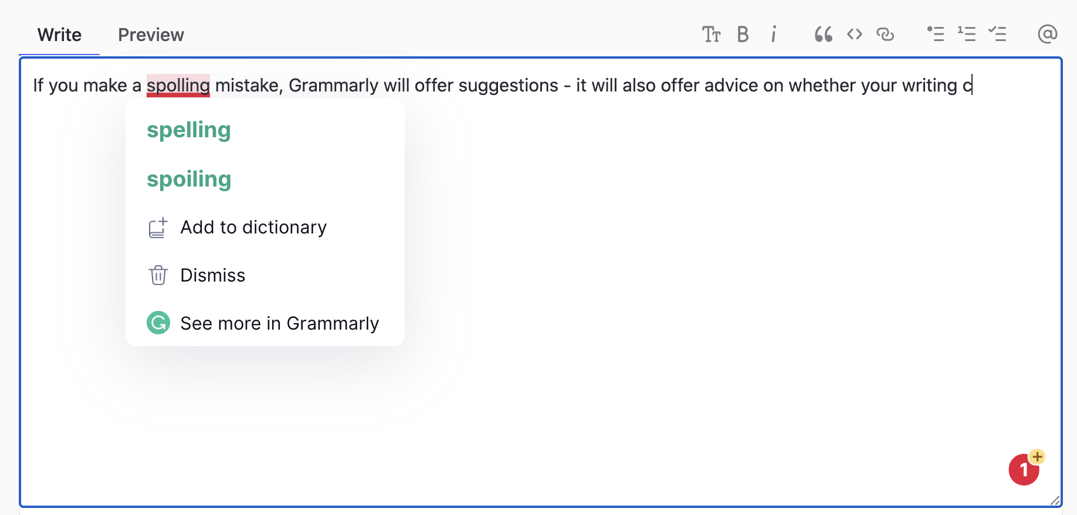
GETTING STARTED - Grammarly
What is Grammarly, and why do we use it?
Grammarly's is an AI-powered writing app that makes sure everything you type is not only correct, but also clear and easy to read. This helps massively when writing clear stories that are clear to all audiences.
Set up Grammarly
a) install Grammarly
b) check that you can see the Grammarly icon in the bottom right corner when writing in ZenHub
Grammarly makes sure everything you type is not only correct, but also clear and easy to read. Grammarly's algorithms flag potential issues in the text and make context-specific suggestions to help with grammar, spelling and usage, wordiness, style, punctuation, and even tone of voice.

Slide 8
PIPELINES OVERVIEW
Pipeline | Description
New Issues | A new incoming issue that has not yet been triaged. Anyone can raise these. Only the Development Manager or Product Owner can triage and move onto another pipeline. See Triage process.
Icebox | No current plans to build this story and it’s on hold until further notice.
Backlog | A prioritized list of development stories, with the most important at the top. All backlog stories should be assigned a milestone. In general, avoid adding an assignee to backlog stories because it slows completion of that story when they’re unavailable (eg, on vacation or tied up).
In Progress | This story is actively being built by a developer. Developers can self-assign stories at the top of the backlog and move to in progress, or these can be assigned by the Development Manager when a developer becomes available.
Waiting 3rd Party | The story is dependent on work outside the control of Applaud, such as a customer, vendor or open-source contributor. Use this pipeline as a last resort and always seek alternatives because this pipeline typically halts progress for prolonged periods of time.
Built but Dependencies | The story is dependent on another Applaud repository. The assignee is still responsible for the timely completion of this story, so active collaboration with the dependency owner is required to ensure aligned delivery of both stories.
Pending Release to Test | The story is coded, checked in and waiting to be applied to a test system. This is a temporary pipeline and stories should move to Design Approval after the next nightly build is applied. During end-of-release code freeze, stories may sit here for multiple days. Not used in all boards.
Design Approval | The story is coded, checked in and on a test system waiting for design and product owner approval. The functionality, configuration options, on-screen text, messages, language, styling and end-user experience will be considered.
QA | The story is waiting QA validation by a QA engineer. Once QA’d they will move to either Pending Release to Prod or Closed. If it fails QA, it moves back to In Progress.
Pending Release to Prod | The story has been QA’d and is waiting application onto production at the end of the milestone. After milestone sign-off, the release team will complete production deployment and move stories onto Closed.
Closed | The story is QA complete and, where applicable, applied onto production. A closed story should never be re-opened.

Slide 9
ACTORS: ACTORS
Teamwork makes the dreamwork! These are the people involved in our development lifecycle
Development Manager
PO can also act by proxy
DM
Dev
Developer
Product Owner
Member of the product management team with authority for the story’s functional area
PO
QA
Quality Assurance Engineer
Release Manager
Individual authorized to perform production deployments
RM

Slide 10
STORY FLOW

Slide 11
NEW ISSUES
A new incoming issue that has not yet been triaged. Anyone can raise these. Only the Development Manager and Product Owner can triage and move onto another pipeline. See Triage process.
Backlog
repo
#1
Some issue
Sprint x – 1.1
Requires estimate and milestone
3
label
Closed
New Issues
DM
repo
#1
DM
Should have invalid, wontfix or duplicate label
Some issue
repo
#1
Some issue
Sprint x – 1.1
DM
label
invalid
Requires estimate; should not have milestone
Icebox
repo
#1
Some issue
3
label

Slide 12
ICEBOX
No current plans to build this story and it’s on hold until further notice.
Backlog
repo
#1
Some issue
Sprint x – 1.1
Requires estimate and milestone
3
label
Closed
Icebox
DM
repo
#1
Should have invalid, wontfix or duplicate label
Some issue
DM
repo
#1
Sprint x – 1.1
Some issue
label
invalid
3
label

Slide 13
BACKLOG
A prioritized list of development stories, with the most important at the top. All backlog stories should be assigned a milestone. In general, avoid adding an assignee to backlog stories because it slows completion of that story when they’re unavailable (eg, on vacation or tied up).
Note: The applaud-cloud board is unique in that it has two separate backlogs Bug backlog - for bugs Feature backlog - for enhancements
In Progress
repo
#1
Some issue
Sprint x – 1.1
Icebox
Backlog
Assigneset
3
label
#1
repo
#1
repo
Some issue
Dev
Some issue
DM
Sprint x – 1.1
DM
3
label
3
label
Closed
Assignee and milestone removed
Should have invalid, wontfix or duplicate label
repo
#1
Some issue
Sprint x – 1.1
label
invalid

Slide 14
IN PROGRESS
A prioritized list of development stories, with the most important at the top. All backlog stories should be assigned a milestone. In general, avoid adding an assignee to backlog stories because it slows completion of that story when they’re unavailable (eg, on vacation or tied up).
Waiting 3rd Party
Icebox
Built but dependencies
repo
#1
repo
#1
Design approval
Some issue
Some issue
Assignee and milestone removed
repo
#1
Sprint x – 1.1
Some issue
repo
#1
Sprint x – 1.1
3
label
In Progress
Some issue
3
label
Sprint x – 1.1
3
label
DM
repo
#1
label
Some issue
Dev
3
Sprint x – 1.1
DM
DM
3
label
Closed
Backlog
Assignee removed
Should have invalid, wontfix or duplicate label + estimate if developer spent time
repo
#1
repo
#1
Some issue
Some issue
Sprint x – 1.1
Sprint x – 1.1
3
label
3
label
invalid

Slide 15
WAITING 3rd PARTY
The story is dependent on work outside the control of Applaud, such as a customer, vendor or open-source contributor. Use this pipeline as a last resort and always seek alternatives because this pipeline typically halts progress for prolonged periods of time.
In progress
Waiting 3rd Party
Closed
repo
#1
repo
#1
repo
#1
Some issue
Some issue
DM
Some issue
Sprint x – 1.1
Dev
Sprint x – 1.1
Sprint x – 1.1
Should have invalid, wontfix or duplicate label + estimate if developer spent time
3
label
3
label
3
label
invalid

Slide 16
BUILT BUT DEPENDENCIES
The story is dependent on another Applaud repository. The assignee is still responsible for the timely completion of this story, so active collaboration with the dependency owner is required to ensure aligned delivery of both stories.
Pending release to test
Built but dependencies
Design approval
repo
#1
Some issue
repo
#1
repo
#1
Sprint x – 1.1
Some issue
Dev
Some issue
Sprint x – 1.1
Sprint x – 1.1
3
label
3
label
3
label

Slide 17
PENDING RELEASE TO TEST
The story is coded, checked in and waiting to be applied to a test system. This is a temporary pipeline and stories should move to Design Approval after the next nightly build is applied. During end-of-release code freeze, stories may sit here for multiple days. Not used in all boards.
Pending release to test
Design approval
repo
#1
repo
#1
Some issue
Dev
Some issue
Sprint x – 1.1
Sprint x – 1.1
3
label
3
label

Slide 18
DESIGN APPROVAL
The story is coded, checked in and on a test system waiting for design and product owner approval. The functionality, configuration options, on-screen text, messages, language, styling and end-user experience will be considered.
If the product owner have feedback regarding anything that is not right, they will add their comments and feedback to the story and move it back into in-progress.
Sometimes there will be times where the feedback is significant enough to warrant being broken out into a new story - in this case, the product team will raise a new story and it will be triaged and prioritised just like any other story - it should NOT be assumed that the overspill story is to be worked on immediately just because it was highlighted by a in-progress story in the current sprint.
In progress
Design approval
QA
repo
#1
repo
#1
repo
#1
Some issue
Some issue
PO
Some issue
PO
Sprint x – 1.1
Sprint x – 1.1
Sprint x – 1.1
3
label
3
label
3
label

Slide 19
QA
The story is waiting QA validation by a QA engineer. Once QA’d they will move to either Pending Release to Prod or Closed. If it fails QA, it moves back to In Progress.
Pending release to prod
In progress
QA
Closed
repo
#1
Some issue
repo
#1
repo
#1
repo
#1
Sprint x – 1.1
Some issue
QA
Some issue
QA
Some issue
Sprint x – 1.1
Sprint x – 1.1
Sprint x – 1.1
3
label
3
label
3
label
3
label

Slide 20
PENDING RELEASE TO PROD
The story has been QA’d and is waiting application onto production at the end of the milestone. After milestone sign-off, the release team will complete production deployment and move stories onto Closed.
Pending release to prod
Closed
repo
#1
repo
#1
Some issue
RM
Some issue
Sprint x – 1.1
Sprint x – 1.1
3
label
3
label

Slide 21
CLOSED
The story is QA complete and, where applicable, applied onto production. A closed story should never be re-opened.
A closed story cannot be re-opened
Closed
repo
#1
Some issue
Sprint x – 1.1
3
label

Slide 22
DEFINING A ‘FEATURE’ STORY

Slide 23
STORY TEMPLATES
All new stories should be created
using one of two story templates:

Slide 24
GENERAL GUIDELINES
Be clearly documented using one of the story templates
Be free of technical jargon and acronyms
Be easily understood by a non-developer
Deliver a testable piece of functionality
Have its outputs clearly defined without risk of ambiguity or individual interpretation
Have no open-issues or outstanding questions

Slide 25
STORY - SUMMARY
A user story is implemented as well as it is communicated. If the context and the goals are made clear, it will be easier for everyone to implement it, test it and refer to it.
A user story should typically have a summary structured this way:
1. As a [user concerned by the story]
1. I want [goal of the story]
1. so that [reason for the story]
The “so that” part is optional if more details are provided in the description.
Do not use “user”, “person” or other generic roles. These are meaningless.
You can read about some reasons for this structure in this article.

Slide 26
STORY - TITLE
The story title is an abbreviated version of the story summary. It’s used as the title in the GitHub issue. For example, if the story summary is:
1. As a employee
1. I want to change my home address
1. so that my payslip is posted to me without a hitch
The title might be “Employee home address change”.
You’ll want to:
Keep it short – just a few words in length
Keep it unique
Keep it free of technical jargon so that anyone can understand it

Slide 27
STORY - ACCEPTANCE CRITERIA
The user story should have a reason to exist: what do I need as the user described in the summary? This part details any detail that could not be passed by the summary.
1. I click on the ”submit” button.
1. A modal window appears if I don’t have enough credits.
1. The modal window contains the following:
1. […]
Since we have mentioned the type of user, the user story can refer to it with “I”. This is useful for consistency and to avoid repetition in the Acceptance criteria. It’s also good to practice a little empathy.
Use the Grammarly Chrome extension to help you with your writing.

Slide 28
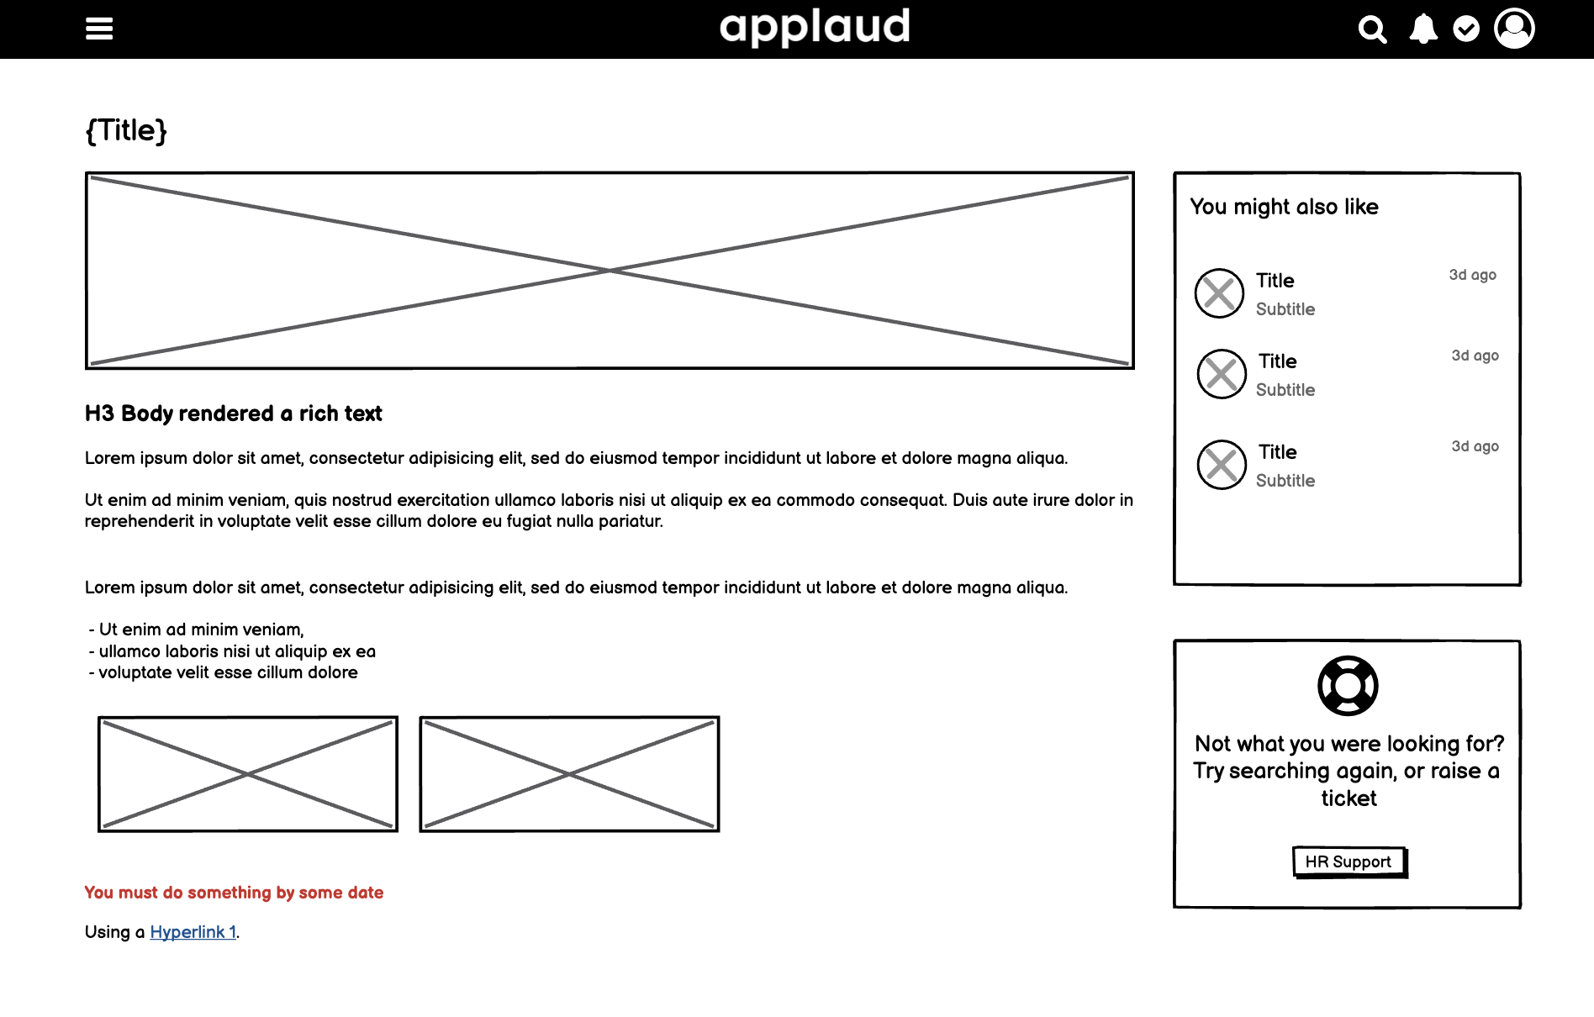
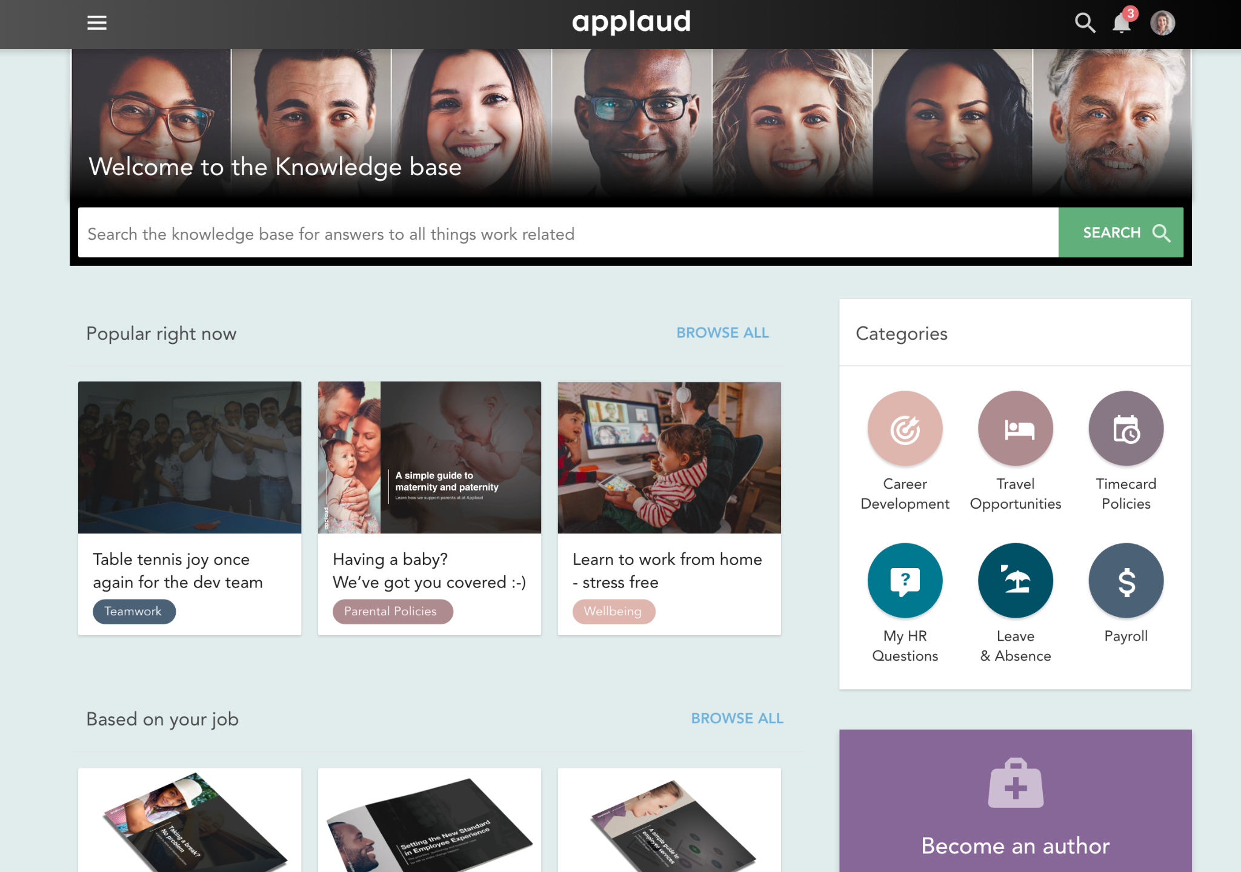
STORY - WIREFRAMES & MOCKUPS
We typically use Balsamiq Cloud for designing low-fidelity wireframes
Include wireframes for all impacted pages & blocks
Focus the scope to just the story concerned and try to avoid including functionality that’s not relevant
Create a wireframe that’s as complete as possible
Use Notes inside the wireframe to annotate, but put open issues/questions inside the Notes section of the story itself
We use Adobe XD if high-fidelity mockups (or animated prototypes) are required for brand new functionality which includes new or updated UI components.
Wireframe
(low-fidelity)
Mockup
(high-fidelity)

Slide 29
STORY - NOTES
Complimentary notes
Eg:
Quote from an email
URL
Background info
Open issues
Questions

Slide 30
RAISING A BUG

Slide 31
HOW TO RAISE A BUG
Always...
Raised the bug on the correct development board
Use the bug template
Complete all of the information as accurately as you can. This will save the development manager time in triaging and estimating the bug. which will mean the product team can prioritise the work more efficiently.
Never...
Assume anybody else will be able to guess what you mean - or expect them to fill in the blanks themselves
Use language which expresses personal frustrations i.e. “The damn workflow keeps getting stuck again”
Add your own estimate - this is the job of the development manager
Add an issue to a milestone or move to the backlog - this is the responsibility of the product team. Despite its immediate impact on you, the bug is always completing with many others

Slide 32
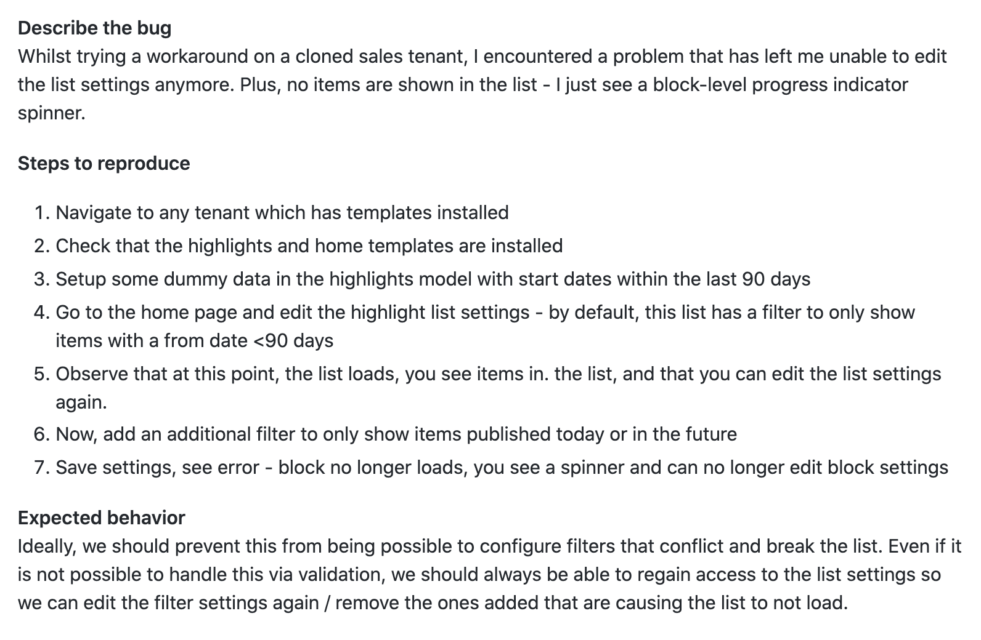
BUG EXAMPLES
Yes please
Clear steps to reproduce
Screenshots / animated gifs showing the issue where possible
No thank you
Lack of detail
No steps to reproduce

Slide 33
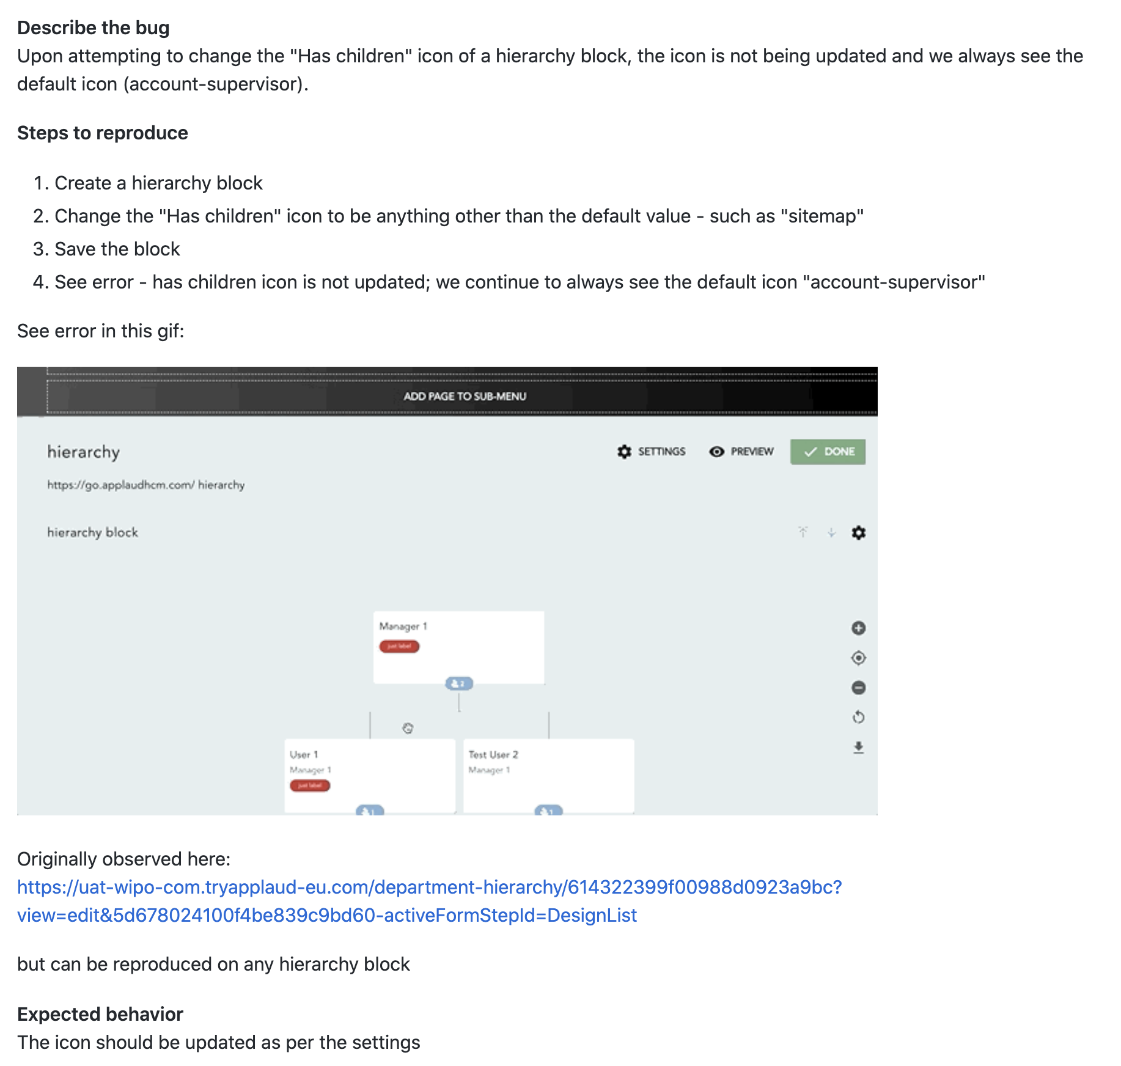
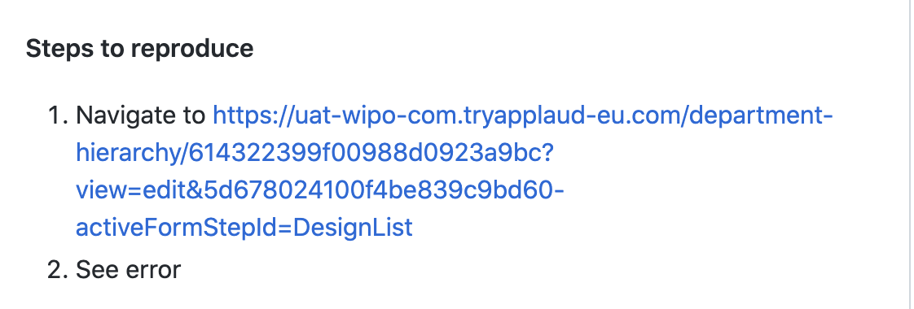
BUG EXAMPLES
Yes please
Clear steps to reproduce
Screenshots / animated gifs showing the issue where possible
No thank you
Lack of detail
No steps to reproduce

Slide 34
RELEASE NOTES

Slide 35
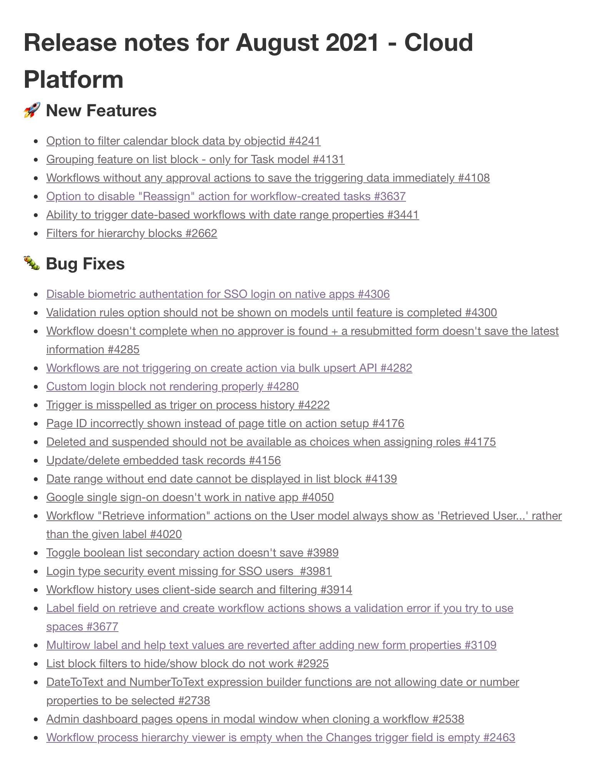
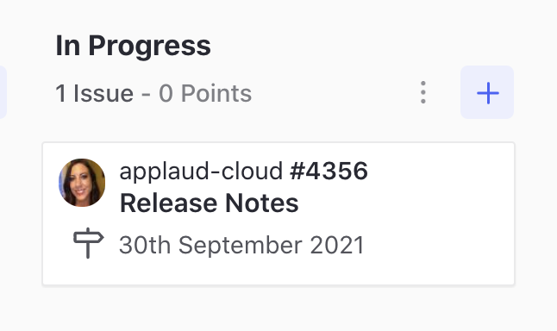
RELEASE NOTES - SUMMARY
Each development milestone has a release notes story - this is a listing of all bugs and enhancements that are planned within this month. The release notes are automatically updated via script each night to ensure stories are added / removed if priorities change.
The release notes story is added to the milestone, but does not need an estimate or epic. The story is assigned to a member of the tech comms team as they will publish the release notes to our support site.
This means there are a couple of points to consider when authoring stories
a) incorrect labelling means something might get shown as a new feature when it isn’t. Bug or enhancement - never both
b) the title of each bug or enhancement is published in the release notes and is therefore visible by all customers and prospects. Poorly written story titles are unhelpful and unprofessional - so make sure to pay attention to the guidelines previously outlined in this document.
See a real set of release notes - this one is from the applaud-cloud development board.

Slide 36
THANK YOU

